Slide 1

Onc BDM India – Steering Committee
Apr-2012

Slide 2
Roadmap – Tracker

Slide 3
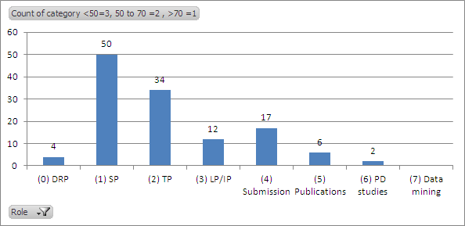
CDRR 2012 at a glance
On track
Steady progress
Slow progress
Not started
Key competencies
Total programmers =50
(0) DRP
(1) SP : Support programmer
(2) TP : Trial programmer
(3) LP/IP : Lead / Indication programmer
(4) Submission activities
(5) Publications (only for GMA)
(6) PD studies (only for CP)
(7) Data mining (only for GMA)
Most of the activities are On track
LP/IP role + PP role have been performed well for at least 1 year
Led submission activities at task level
Contributions to OBBI programming activities
OTM task level lead programming
PD studies for CP
OTM trial and lead programmer role (barring Murali on OBBI and Sudarshan)
Data mining activities for GMA
Need to streamline DRP activities

Slide 4
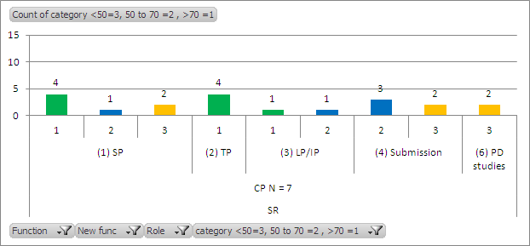
Road-map tracker – CDRR CP 2012
Group | Key Competencies | Way forward
CP Lead programmer – start, under supervision,1-2ftes. Submission support, task level TP – eligible associates as per global criteria PD studies, non-standard | Lead Programmer Resourcing / planning timelines for delivery Communication/co-ordination across functions Managing CROs Mentoring Negotiations Submission support Advanced SAS skills / domain knowledge Contributions to the pooling plans Work under crunched timelines PD studies, non-standard PK, TQT Domain knowledge | Develop expertise in PD studies and PK QT studies Continue to give opportunities at trial level to new hires Develop pharmacological understanding to contribute more
On track:
LP role maturing
Co-led submission activities at task level
Submission activities
Working with CROs/FSPs
Areas to work on:
PD studies for CP
Notes:
Current Status
People
Sini has left,
Murali transitioned to OBBI,
Jayachand K has joined the team
Lead Programmer
Murali for PI3K program – replacement needed to be identified, could be Jayachand
Co-ordination, esourcing / planning and delivery
Full LDE program to be supported out of India <need clarity on the outsourcing strategy>
Submission support
LBH – co-led by Deepak/Hong
SMS – 2 studies by Deepak Complete
RAD meta analysis for Murali <need clarity>
SOM support Complete
PD/non-standard PK/QT
None so far
FSP model with Cytel begun on RAD study

Slide 5
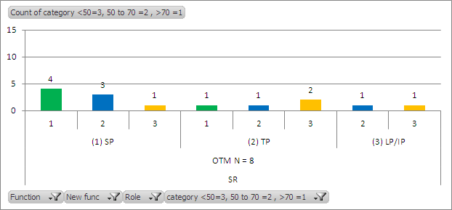
Road-map tracker – CDRR OTM/OBBI 2012
Group | Key Competencies | Way forward
OTM Lead programmer – start, under supervision. TP – eligible associates as per global criteria OBBI Biomarkers – start, build to reach 1 Full FTE | Lead Programmer Resourcing / planning timelines for delivery Communication/co-ordination across functions Managing CROs Mentoring Negotiations Biomarkers Collaboration with the Biomarker scientists, Biomarker stats Project overview / cross project work Domain knowledge, knowledge about standards Understanding of R, splus | OTM Develop support programmers to trial programmers It would take some time 1 year -2 years to develop Lead programmer – already begun with Sudarshan OBBI Complete the sample code generation task for standard assays Contribute more to exploratory work
On track:
Task level activities for TP roles
Contributions to OBBI standardization activities / cross project analysis
Hiring programmers for OTM group
Areas to work on:
TP role
LP role (Murali on OBBI and Sudarshan)
7 OTM + 1 OBBI = OTM 7 programmers, LP is for OBBI Murali and Sudarshan

Slide 6
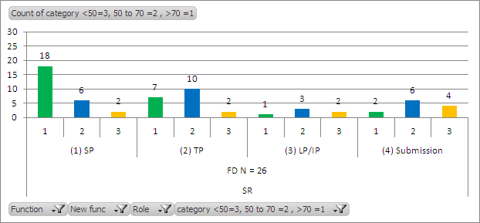
Road-map tracker – CDRR FD 2012
Group | Key Competencies | Way forward
FD TP – at least one for each project supported by India, new within global timelines. Indication programmer – start under supervision. Submission support – start build capabilities | Indication Programmer Resourcing / planning timelines for delivery Communication/co-ordination across functions Managing CROs Mentoring Negotiations Submission support Advanced SAS skills / domain knowledge Contributions to the pooling plans Work under crunched timelines | More TP roles can be taken on Submission activities full range of activities
On track:
TP roles across each project
IP / PP role have begun
Key contributions to submission activities at task level
Areas to work on:
Key contributions to submission activities at task level
Notes:
Current Status
Indication Programmer
None identified yet, looking for Hari’s replacement
Trial Programmer
Currently have one for every project <to be updated after CDRR announcement>
Submission support
Submission support at task level for multiple projects – RAD pNET, TSC, LBH

Slide 7
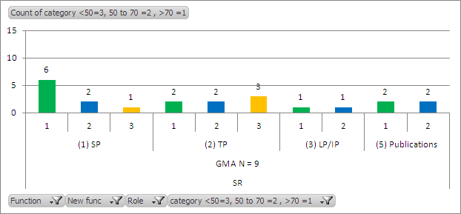
Road-map tracker – CDRR GMA 2012
Group | Key Competencies | Way forward
GMA TP role – start Enhance support for pubs/presentations Lead programmer – develop existing resources. Data mining/graphics – start | Lead Programmer Resourcing / planning timelines for delivery Communication/co-ordination across functions Managing CROs Mentoring Negotiations Support for pubs/presentations Quick turn-around time Data mining / graphics Technical competence | Develop support programmers to trial programmers Increase the level of competence of the existing trial programmers Data mining – start having discussions with Abdel and Yvane to determine strategy and direction for data mining
On track:
LP/ TP roles across each project
Key contributions to publications activities
Areas to work on:
LP/TP role
Not started:
Data mining
Notes:
Current Status
Trial Programmer
All GMA SR associates
Lead Programmer
Jayapandian and Ashish for Exjade and SOM/SMS
Participate in resourcing / planning
Attend project meetings
CRO coordination
Led a complex study independently
Support for pubs
On going with 2 associates, 9 so far this year
Planned for additional 4 this year
Data mining/graphics
No support currently

Slide 8
Road-map tracker – CDRR Other 2012
Group | Key Competencies | Current Status | Way forward
Other Japan – 2 FTE China – align resources to plan. CRO – 4-5 OSC, pilot FSP |  | Japan There is no Japan specific resource assigned Different projects manage Japanese studies within the projects China Currently on hold CRO/FSP FSP in India (Cytel, TAKE) –projects started for CP, FD trials Cytel quality not up to the mark (various examples) TCS will start with 10 programmers – initial phase | With changing group structures across CDRR do we need this? Or is it OK to remove this section
DRP | DRP programmer: SAS, Jreview, Patient profile, Protocol deviations, exception reports, DVC, ADVANCE studies Legacy studies LSH programmer | 3 programmers | Better integration into CDRR group More collaboration between SR and DR group More developmental opportunities to build career OSC support in India – approx 6 programmers Possible merger into one group (SR + DR) with no differentiation

Slide 9
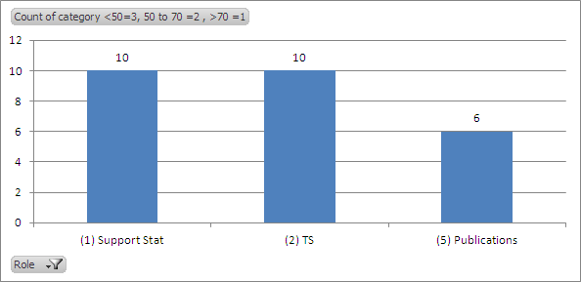
Bios 2012 at a glance
On track
Steady progress
Slow progress
Not started
Total statisticians = 10
Support statisticians
Trial statisticians
Publications (Only for GMA)
Key competencies
Most of the activities are On track
Key contributions to publication support for GMA trials
OTM Stat role initiated

Slide 10
Road-map tracker – Bios 2012
Group | Key Competencies | Way forward
CP TS – full role, including protocol dev under supervision | Trial Statistician Protocol design Analysis plans, FIR, interpretation Ability to provide functional input into CTTs | Continue to coach/mentor associates Increase complexity of studies that Hyd associates work on Increase level of Bios expertise through regular Bios forums at local level
OTM Start supporting stat role, RAP,CSR, input to protocol, protocol amendments-TS level tasks under supervision. | Support Statistician RAP, FIR, interpretation Input to protocol | Currently have only 1 associate, think about expanding this team Increasing complexity of work
FD TS – full role – 2 FTE OPRC review (Mahesh) | Trial Statistician Protocol design Analysis plans, FIR, interpretation Ability to provide functional input into CTTs In some ED studies, does escalation t/c;s | Continue to coach/mentor associates Increase complexity of studies that Hyd associates work on Increase level of Bios expertise through regular Bios forums at local level
GMA TS – full role (1-2fte’s) Enhance support for pubs/presentations Exploratory analysis – start | Trial Statistician Protocol design Analysis plans, FIR, interpretation Ability to provide functional input into CTTs Enhance support for pubs Domain/Bios knowledge Exploratory analyses Domain/Bios knowledge | Continue to coach/mentor associates Increase complexity of studies that Hyd associates work on Increase level of Bios expertise through regular Bios forums at local level

Slide 11
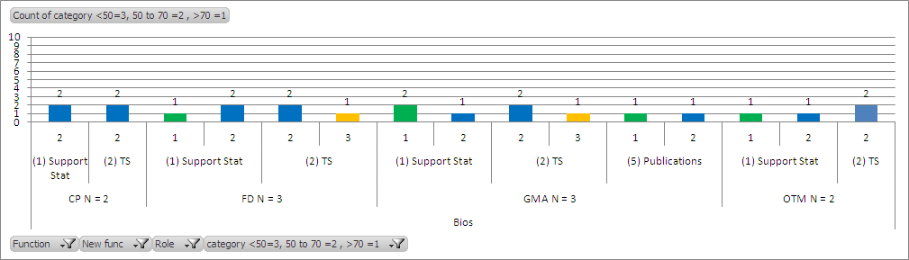
Road-map tracker – Bios 2012

Slide 12
Data from 2011

Slide 13
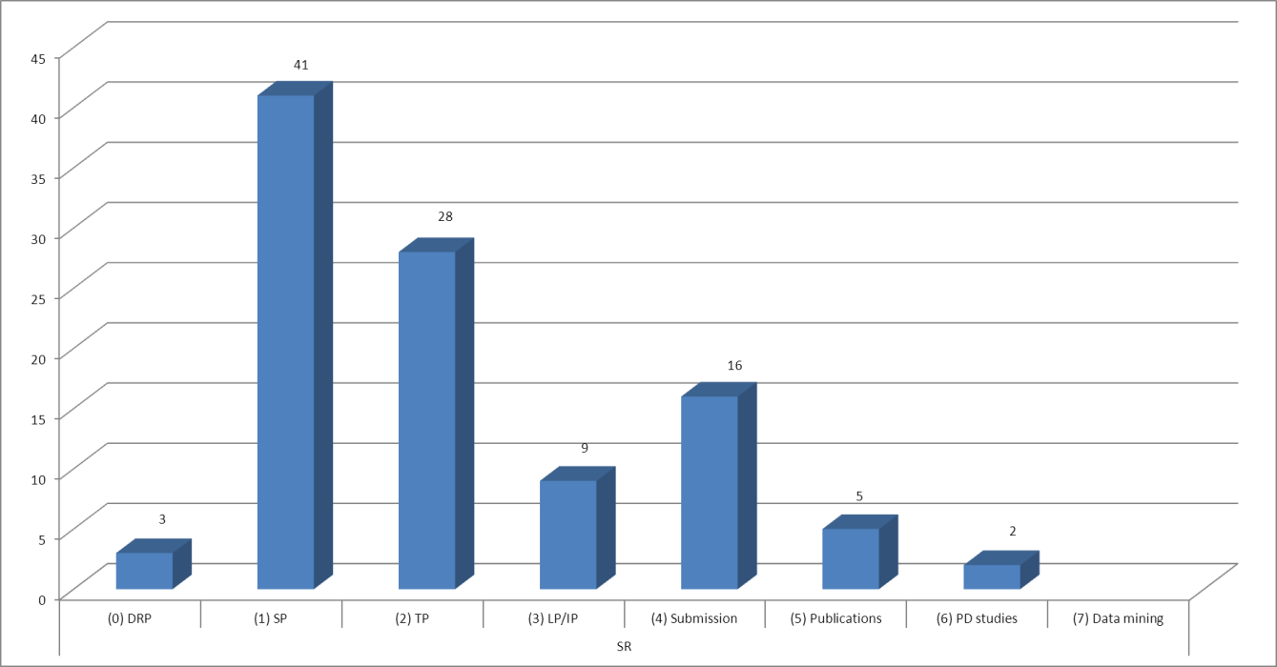
CDRR 2011 at a glance
On track
Steady progress
Slow progress
Not started
Key competencies
Total programmers =44
(0) DRP
(1) SP : Support programmer
(2) TP : Trial programmer
(3) LP/IP : Lead / Indication programmer
(4) Submission activities
(5) Publications (only for GMA)
(6) PD studies (only for CP)
(7) Data mining (only for GMA)
Most of the activities are On track
LP/IP role + PP role have begun
Led submission activities at task level
Contributions to OBBI programming activities
OTM task level lead programming
PD studies for CP
OTM trial and lead programmer role (barring Murali on OBBI)
Data mining activities for GMA

Slide 14
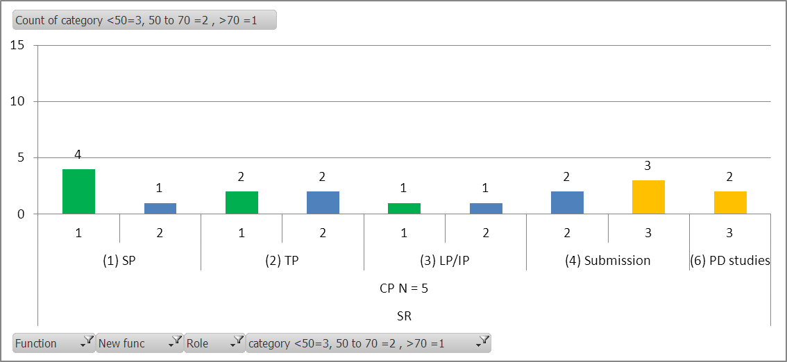
Road-map tracker – CDRR CP 2011
Group | Key Competencies | Way forward
CP Lead programmer – start, under supervision,1-2ftes. Submission support, task level TP – eligible associates as per global criteria PD studies, non-standard | Lead Programmer Resourcing / planning timelines for delivery Communication/co-ordination across functions Managing CROs Mentoring Negotiations Submission support Advanced SAS skills / domain knowledge Contributions to the pooling plans Work under crunched timelines PD studies, non-standard PK, TQT Domain knowledge | Get better quality of deliverables from CROs/FSP partners Develop expertise in PD studies and PK QT studies Continue to give opportunities at trial level to new hires Develop pharmacological understanding to contribute more
On track:
LP role maturing
Co-led submission activities at task level
Areas to work on:
Submission activities
PD studies for CP
Notes:
Current Status
People
Sini has left,
Murali transitioned to OBBI,
Jayachand K has joined the team
Lead Programmer
Murali for PI3K program – replacement needed to be identified, could be Jayachand
Co-ordination, esourcing / planning and delivery
Full LDE program to be supported out of India <need clarity on the outsourcing strategy>
Submission support
LBH – co-led by Deepak/Hong
SMS – 2 studies by Deepak Complete
RAD meta analysis for Murali <need clarity>
SOM support Complete
PD/non-standard PK/QT
None so far
FSP model with Cytel begun on RAD study

Slide 15
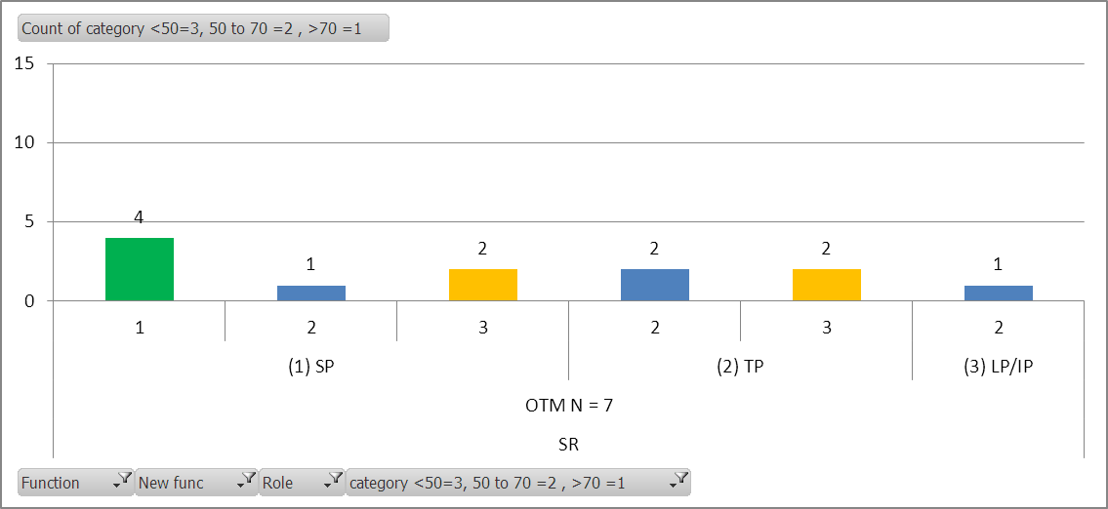
Road-map tracker – CDRR OTM/OBBI 2011
Group | Key Competencies | Way forward
OTM Lead programmer – start, under supervision. TP – eligible associates as per global criteria OBBI Biomarkers – start, build to reach 1 Full FTE | Lead Programmer Resourcing / planning timelines for delivery Communication/co-ordination across functions Managing CROs Mentoring Negotiations Biomarkers Collaboration with the Biomarker scientists, Biomarker stats Project overview / cross project work Domain knowledge, knowledge about standards Understanding of R, splus | OTM Develop support programmers to trial programmers It would take some time 1 year -2 years to develop Lead programmer OBBI Complete the sample code generation task for standard assays Contribute more to exploratory work
On track:
Task level activities for TP roles
Contributions to OBBI standardization activities / cross project analysis
Hiring programmers for OTM group
Areas to work on:
TP and LP role (barring Murali on OBBI)
Not started:
LP role
5.5 OTM + 1.5 OBBI = OTM 7 programmers, LP is for OBBI (Murali)

Slide 16
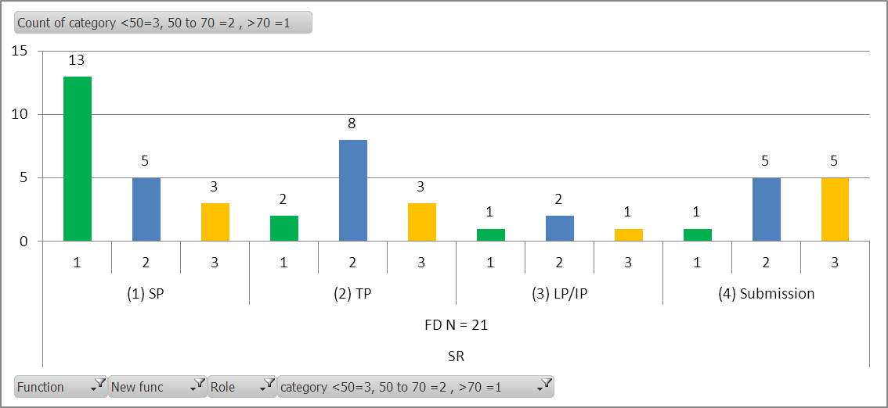
Road-map tracker – CDRR FD 2011
Group | Key Competencies | Way forward
FD TP – at least one for each project supported by India, new within global timelines. Indication programmer – start under supervision. Submission support – start build capabilities | Indication Programmer Resourcing / planning timelines for delivery Communication/co-ordination across functions Managing CROs Mentoring Negotiations Submission support Advanced SAS skills / domain knowledge Contributions to the pooling plans Work under crunched timelines | More TP roles can be taken on Submission activities full range of activities
On track:
TP roles across each project
IP / PP role have begun
Key contributions to submission activities at task level
Areas to work on:
Key contributions to submission activities at task level
Notes:
Current Status
Indication Programmer
None identified yet, looking for Hari’s replacement
Trial Programmer
Currently have one for every project <to be updated after CDRR announcement>
Submission support
Submission support at task level for multiple projects – RAD pNET, TSC, LBH

Slide 17
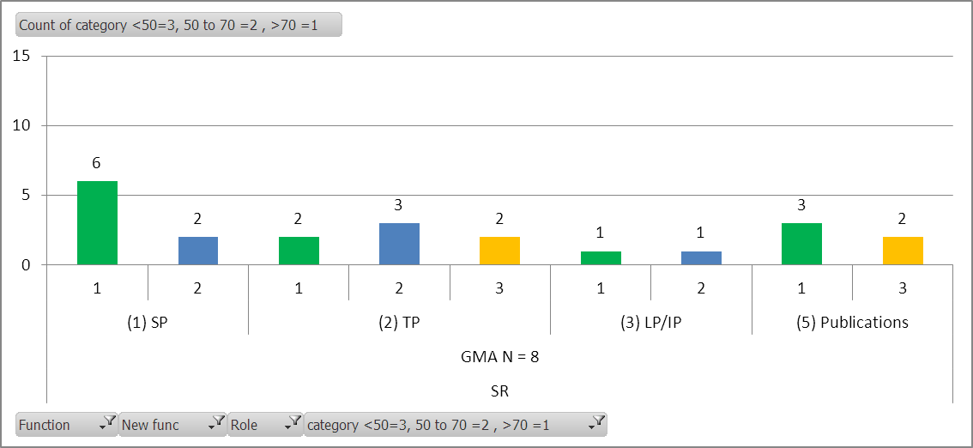
Road-map tracker – CDRR GMA 2011
Group | Key Competencies | Way forward
GMA TP role – start Enhance support for pubs/presentations Lead programmer – develop existing resources. Data mining/graphics – start | Lead Programmer Resourcing / planning timelines for delivery Communication/co-ordination across functions Managing CROs Mentoring Negotiations Support for pubs/presentations Quick turn-around time Data mining / graphics Technical competence | Develop support programmers to trial programmers Increase the level of competence of the existing trial programmers Data mining – start having discussions with Abdel and Yvane to determine strategy and direction for data mining
On track:
LP/ TP roles across each project
Key contributions to publications activities
Areas to work on:
LP/TP role
Not started:
Data mining
Notes:
Current Status
Trial Programmer
All GMA SR associates
Lead Programmer
Jayapandian and Ashish for Exjade and SOM/SMS
Participate in resourcing / planning
Attend project meetings
CRO coordination
Led a complex study independently
Support for pubs
On going with 2 associates, 9 so far this year
Planned for additional 4 this year
Data mining/graphics
No support currently

Slide 18
Road-map tracker – CDRR Other 2011
Group | Key Competencies | Current Status | Way forward
Other Japan – 2 FTE China – align resources to plan. CRO – 4-5 OSC, pilot FSP |  | Japan There is no Japan specific resource assigned Different projects manage Japanese studies within the projects China Currently on hold CRO/FSP FSP in India (Cytel, TAKE) –projects started for CP, FD trials Cytel quality not up to the mark (various examples) TCS will start with 10 programmers – initial phase | With changing group structures across CDRR do we need this? Or is it OK to remove this section
DRP | DRP programmer: SAS, Jreview, Patient profile, Protocol deviations, exception reports, DVC, ADVANCE studies Legacy studies | 3 programmers | Better integration into CDRR group More collaboration between SR and DR group More developmental opportunities to build career OSC support in India – approx 6 programmers Possible merger into one group (SR + DR) with no differentiation

Slide 19
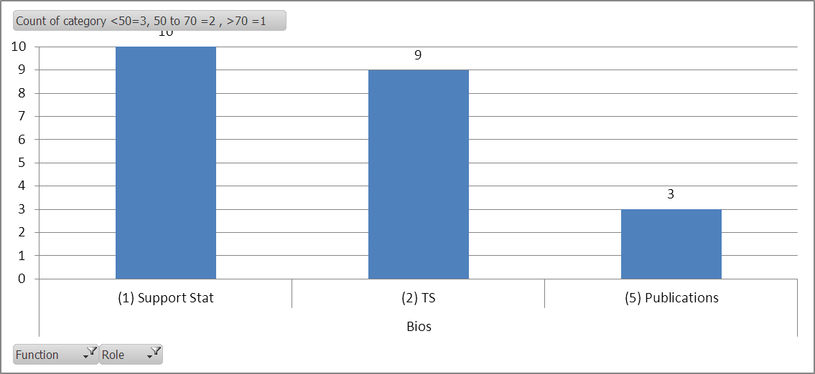
Bios 2011 at a glance
On track
Steady progress
Slow progress
Not started
Total statisticians = 10
Support statisticians
Trial statisticians
Publications (Only for GMA)
Key competencies
Most of the activities are On track
Key contributions to publication support for GMA trials
OTM Stat role initiated

Slide 20
Road-map tracker - Bios
Group | Key Competencies | Way forward
CP TS – full role, including protocol dev under supervision | Trial Statistician Protocol design Analysis plans, FIR, interpretation Ability to provide functional input into CTTs | Continue to coach/mentor associates Increase complexity of studies that Hyd associates work on Increase level of Bios expertise through regular Bios forums at local level
OTM Start supporting stat role, RAP,CSR, input to protocol, protocol amendments-TS level tasks under supervision. | Support Statistician RAP, FIR, interpretation Input to protocol | Currently have only 1 associate, think about expanding this team Increasing complexity of work
FD TS – full role – 2 FTE OPRC review (Mahesh) | Trial Statistician Protocol design Analysis plans, FIR, interpretation Ability to provide functional input into CTTs In some ED studies, does escalation t/c;s | Continue to coach/mentor associates Increase complexity of studies that Hyd associates work on Increase level of Bios expertise through regular Bios forums at local level
GMA TS – full role (1-2fte’s) Enhance support for pubs/presentations Exploratory analysis – start | Trial Statistician Protocol design Analysis plans, FIR, interpretation Ability to provide functional input into CTTs Enhance support for pubs Domain/Bios knowledge Exploratory analyses Domain/Bios knowledge | Continue to coach/mentor associates Increase complexity of studies that Hyd associates work on Increase level of Bios expertise through regular Bios forums at local level

Slide 21
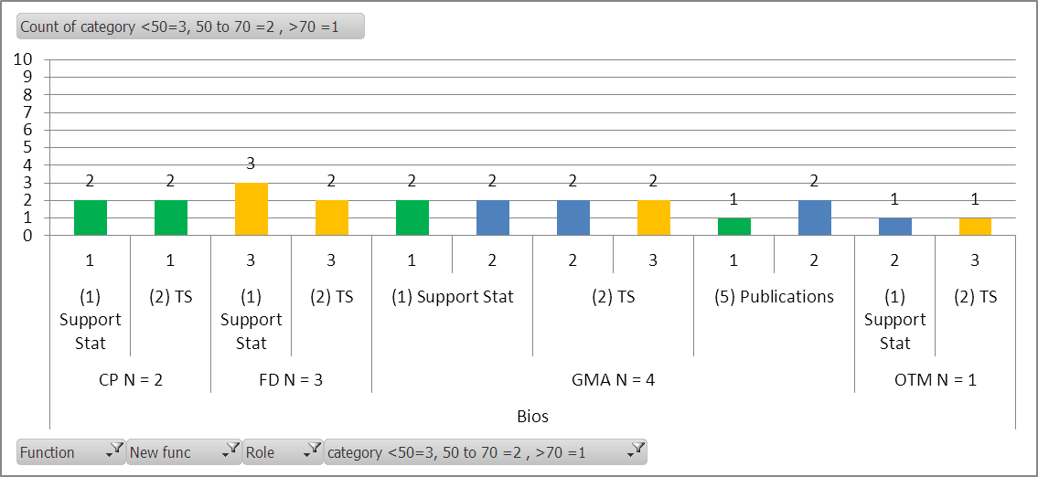
Road-map tracker - Bios

